Slide 1
STEPS OF CARBON CYCLE
Running Head: STEPS OF CARBON CYCLE 1
Name of the Student
Institutional Affiliation
Date of Submission

Slide 2
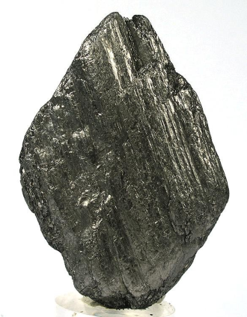

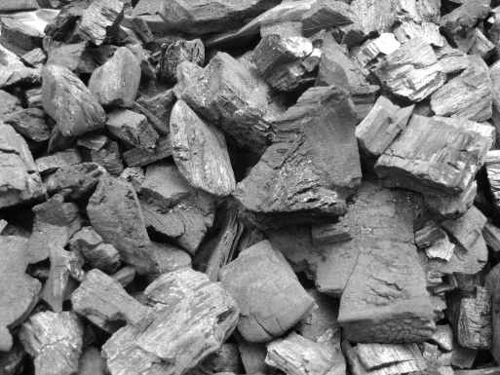
STEPS OF CARBON CYCLE 3
Introduction
Carbon is one of the most abundant elements found on the Earths surface as well as in the atmosphere. The element exists in different states and forms. The solid forms of carbon include graphite, diamond charcoal and coal among others.
Graphite Diamond Charcoal
The gaseous forms of carbon include Carbon (IV) Oxide (CO₂) and Carbon (II) Oxide (CO). Carbon (IV) Oxide (CO₂) occupies approximately third of the Earth’s atmospheric gases ("Fundamentals: Gases," 2008).
Carbon has a unique ability to form strong bonds with four other atoms. This quality enables it to form several compounds such as the hydrocarbons with other elements in nature such as oxygen and hydrogen.
Carbon is found in abundant amounts within the structures of living organisms. Most of the components that living organisms (such as fats, oils, proteins and the DNA) are made of have contain carbon. It therefore means that that life would be non-existent without this important element.

Slide 3
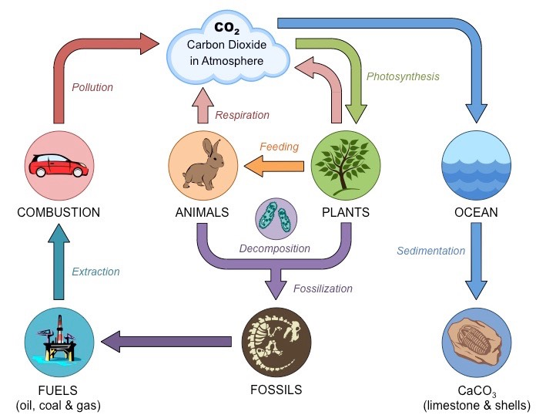
STEPS OF CARBON CYCLE 2
Definition of Carbon Cycle
Carbon cycle refers to the process through which carbon moves from the atmosphere into the Earth’s surface and living things and then back into the atmosphere.
The cycle the nature’s mechanism of balancing carbon concentration in different places and for using it for purposes.
Pictorial Representation of Carbon Cycle

Slide 4

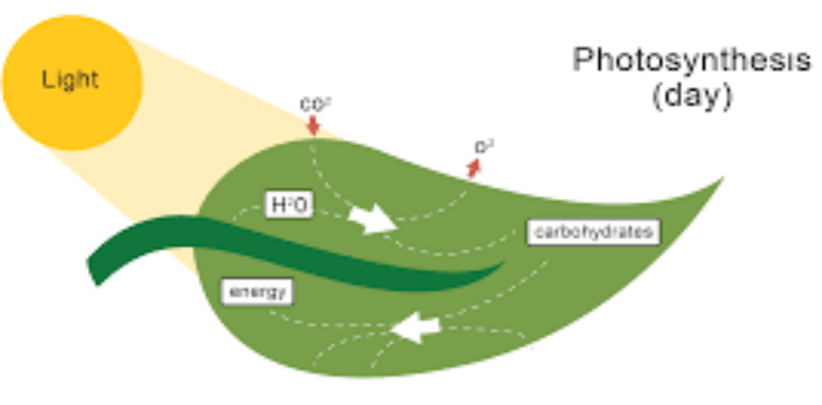
STEPS OF CARBON CYCLE 4
Carbon Cycle involves six main steps:
  Photosynthesis
  Feeding by animals
  Death and Decomposition of living organisms
  Respiration and combustion of wood, charcoal and fossil fuels and volcanic eruptions.
  Absorption of Carbon(IV) oxide by water bodies.
  Photosynthesis
  Photosynthesis is the process through which green plants utilize Carbon(IV) Oxide (CO₂) gas( a compound of carbon) and water to manufacture glucose. Plants use glucose to generate energy or convert it to other useful forms such as starch.
  The process of photosynthesis required the input of sunlight energy. The plants trap sunlight energy using a special pigment known as chlorophyll(GCSE Biology, 2005).
  The purpose of sunlight energy is to facilitate photolysis of water (splitting of water molecules into oxygen atoms and hydrogen ions).The hydrogen ions combine with Carbon (IV) Oxide to form simple sugar(glucose) while oxygen gas is released into the atmosphere as a waste product.
  Chemical equation of Photosynthesis.

Slide 5
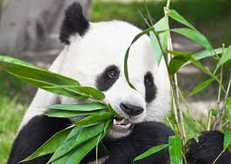
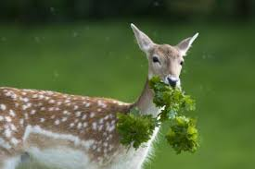
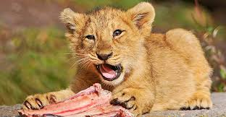
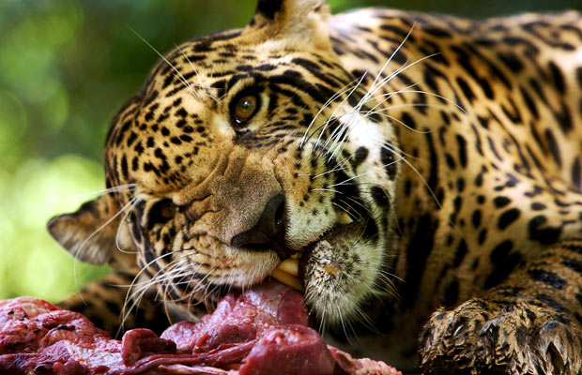
STEPS OF CARBON CYCLE 5
Feeding by Animals
Animals require food for survival. Most animals (herbivores and omnivores) obtain their food from plants. In the process of feeding, animals obtain carbon from the leaves, stems or twigs of plants which they eat as food.
Animals which feed on meat also obtain carbon from the proteins which make up the tissues of living organisms. The carbon gets incorporated into their tissues after the proteins have been digested to constituent amino acids. The amino acids are the building blocks of proteins.

Slide 6
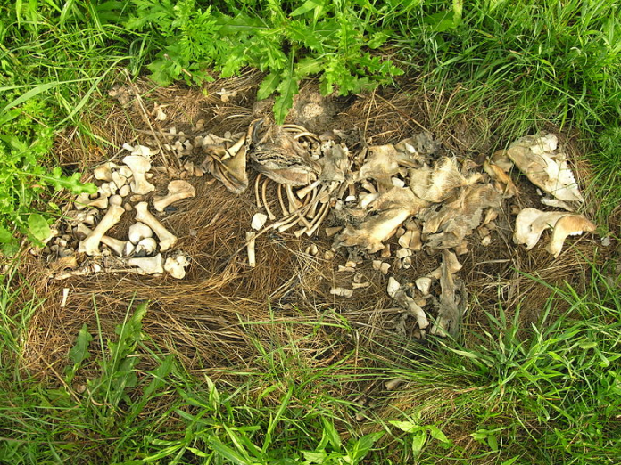
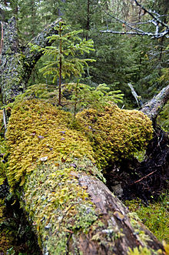
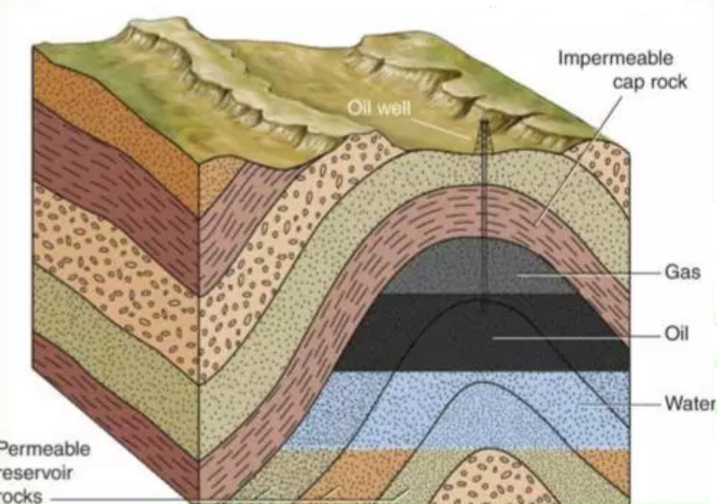
STEPS OF CARBON CYCLE 6
Death and Decomposition of Living Organisms
After the death of living organisms, decomposing sets in. In the process, the proteins, carbohydrates and fats which make up their structures are broken down by bacteria and saprophytic fungi to release carbon compounds such as methane, carbon (IV) Oxide and ammonia.
Some of the carbon components released during decomposition seeps deep into the ground and form fossil fuels such as oil, natural gas and coal after millions of years.

Slide 7
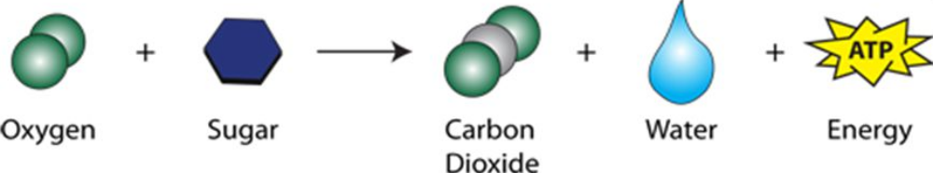
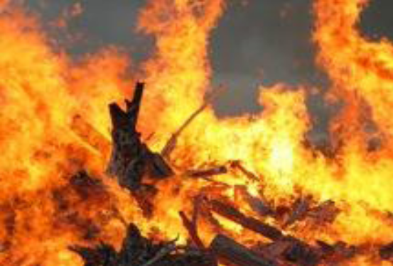
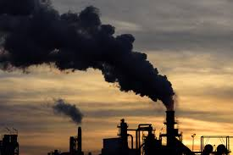
STEPS OF CARBON CYCLE 7
Respiration
During respiration, living organisms use up oxygen to break down respiratory substrates such as glucose, lipids and proteins.
The process results in the formation of energy( ATP),Carbon (IV)Oxide and water are liberated as waste products (UCSB Science Line, 2002).
The energy generated is used in the physiological processes such as active transport, contraction of muscles, cell division and transmission of nerve impulses.
If metabolic wastes such as Carbon (IV) Oxide and water accumulate in the cells of living organisms, they may be toxic. Therefore, these byproducts are released into the atmosphere through the nostrils(during exhalation).
Combustion of Charcoal, wood and Fossil Fuels
When charcoal, wood and fossil fuels are burnt, they liberate Carbon (IV) Oxide and soot into the atmosphere.
Each year, approximately 5.5 billion tones Carbon is released from the combustion of fossil fuels in auto engines and factories. ("Carbon Dioxide: How many pounds of CO2 go into the atmosphere from one gallon of gas?," 2017)
Combustion of wood Combustion of fossil fuels

Slide 8
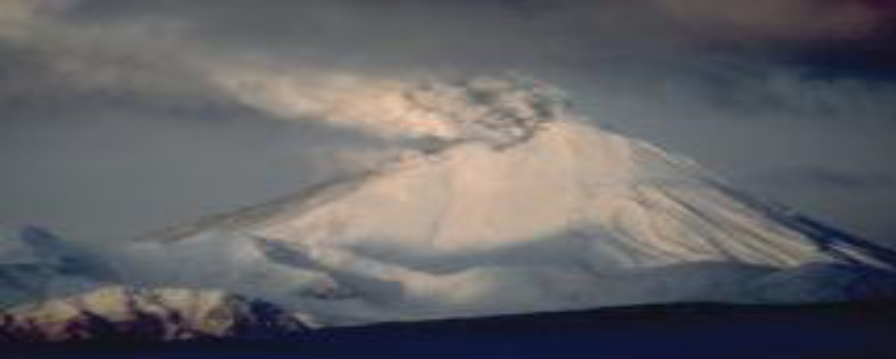
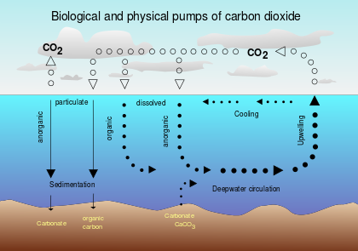
STEPS OF CARBON CYCLE 8
Volcanic Eruptions and Oceans
Whenever they occur, volcanic eruption release huge amounts of carbon(II) Oxide and carbon(IV) Oxide. It is estimated that a single eruption can release an equal amount of carbon as released from human pollution for 250 years.
In as much as oceans absorb carbon from the atmosphere in the form of carbon (IV) Oxide, they release almost a similar quantity as the much they absorb.
Volcanic Eruptions are a major source of carbon (IV) Oxide in the atmosphere
Carbon cycle in oceans

Slide 9
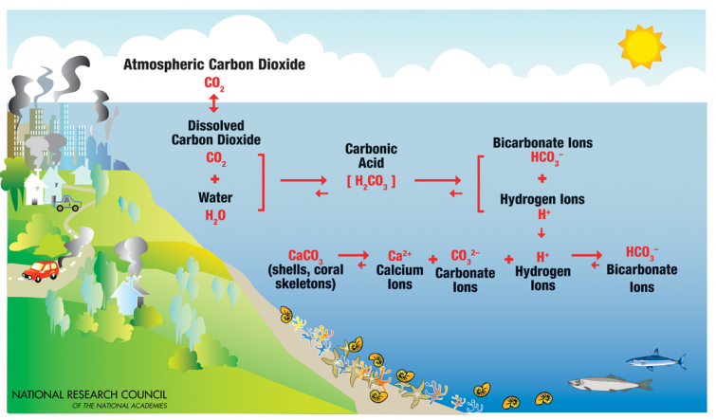
STEPS OF CARBON CYCLE 9
Absorption of Carbon(IV)Oxide by Oceans
Oceans form the largest reservoir of dissolved Carbon(IV) oxide("Lecture 4:The present carbon cycle," n.d.). They absorb atmospheric Carbon(IV) Oxide and store it in dissolved form ( weak Carbonic acid) through the process of diffusion.
Oceans are becoming increasingly acidic due to the large quantity of carbon (IV) oxide released into the atmosphere from human activity.
The huge difference in the concentration of carbon(IV) Oxide between the atmosphere and the ocean water leads to rapid absorption of atmospheric carbon(IV) Oxide by the oceans.
Once in the oceans, dissolved carbon(IV) Oxide( weak carbonic acid reacts with calcium carbonate(in the coral reefs and sea shells) to form calcium ions and bicarbonate ions.

Slide 10
STEPS OF CARBON CYCLE 10
Importance of Carbon Cycle
Carbon (IV) oxide is a green house gas. If its concentration in the atmosphere is not properly put in check( through carbon cycle), serious consequences might result. The temperature of the earth can rise to inhospitable levels making it difficult to for the different life forms to exist. Most life forms may die to extremely high temperatures leading to loss of biodiversity.
Carbon cycle plays a critical role in supporting life on Earth. Without the cycle, it could be impossible for life to exist since there would be no plants for animals to feed on. Consequently all animals may die as a result of lack of food including those that feed on flesh.
Carbon cycle also plays a crucial role in generation of fossil fuels In the modern world, people depend on fossil fuels for several purposes. For example, fossil fuels are required to run the engine of cars, airplanes and other machinery. The fuels are also used for other purposes such as heating in factories and generation of electricity. Without these fuels, crucial aspects of human life may be severely hampered.
Decomposition of animals and plants helps replenish the supply of carbon into the environment. If carbon is depleted, important life processes such as photosynthesis may not be possible. This can lead to severe food shortage and ultimately death of all living organisms on Earth which depend on plants either directly or indirectly for food and shelter.

Slide 11
STEPS OF CARBON CYCLE 11
Importance of Carbon Cycle Continued…
Absorption of atmospheric carbon IV oxide by oceans is useful in reducing the concentration of the gas in the atmosphere. High concentrations of the carbon IV oxide is associated with global warming which is currently a global issue. Oceans thus play a critical role in reducing the negative impacts of excess carbon in the atmosphere such as global warming.
Elimination of carbon (IV) oxide during respiration is critical to the survival of cells. The gas is a metabolic waste and if left to accumulate in the cells, it can become toxic ( due to its acidic nature) and lead to death of the cells affected. In severe cases, death can result if vital organs are affected by the accumulation.

Slide 12
STEPS OF CARBON CYCLE 10
References
Carbon Dioxide: How many pounds of CO2 go into the atmosphere from one gallon of gas? (2017). Retrieved from http://www.greenuniversity.com/Green_Economics/carbondioxide.htm
Fundamentals: Gases. (2008). Air Pollution Control Equipment Calculations, 27-67. doi:10.1002/9780470255773.ch3
Lecture 4:The present carbon cycle. (n.d.). Retrieved from http://www.am.ub.edu/~jmiralda/fsgw/lect4.html
GCSE Biology. (2005). What is Photosynthesis? Retrieved from https://moodle.beverleyhigh.net/mod/resource/view.php?id=6092
UCSB Science Line. (2002, September 7). How are respiration and photosynthesis related. Retrieved from http://scienceline.ucsb.edu/getkey.php?key=153

